Slide 1
EETS 8355: data center network engineering
M. Scott Kingsley

Slide 2
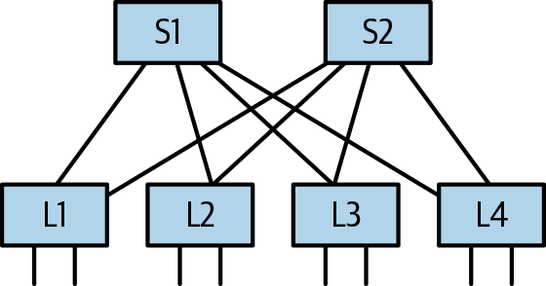
Calculating Max Number of Servers
Assumptions
n-port switches for both leaf and spine
All n-ports have same bandwidth
1:1 (non-blocking) oversubscription
Max servers that can be connected in two tier Clos topology is n²/2.
4 ports: 4²/2 = 8 servers
32 ports: 32²/2 = 512 servers
64 ports: 62²/2 = 2,048 servers
128 ports: 128²/2 = 8,192 servers
40 servers per rack

Slide 3
Calculating Max Number Switches
Assumptions
2-tier Clos
n-port switches for both leaf and spine
All n-ports have same bandwidth
1:1 (non-blocking) oversubscription
Each leaf connects half of ports to spines, half to servers.
Spine switches only connect to leaves.
Max switches is n + (n/2).
4 ports = 4 = (4/2) = 6
32 ports: 32 + (32/2) = 48 switches
64 ports: 64 + (64/2) = 96 switches
128 ports: 128 + (128/2) = 192 switches
2x switches = 4x servers

Slide 4
Interconnecting links
Common configurations
10 GbE/10 GbE
10 GbE/40 GbE
25 GbE/100 GbE* or higher
Higher ISL’s use fewer spine switches for same oversubscription rate.
40 servers connected with 10 GbE = 40 spines
40 server connected with 40 GbE = 10 spines

Slide 5
Interconnecting links
However, some data centers use low server and ISL’s (10 GbE/10GbE). Why?
Build larger networks
32-port switches with 40 GbE ISL’s = 32²/2 = 512 servers
32-port switches with 4*10 GbE ISL’s = 128-20 = 108²/2 = 5,832 servers
Better load balancing
Half of 32 40 GbE ports = 16 spine switches
Half of 32*4 10 GbE ports = 54 spine switches
Increased survivability
Failure of one link with 40 GbE = 1/16 bandwidth loss
Failure of one link with 10 GbE = 1/54 bandwidth loss

Slide 6
Limitations
Power limitations
May limit number of servers in 40 server rack to 20
Other engineering limitations
Moving from switching to routing architectures

Slide 7
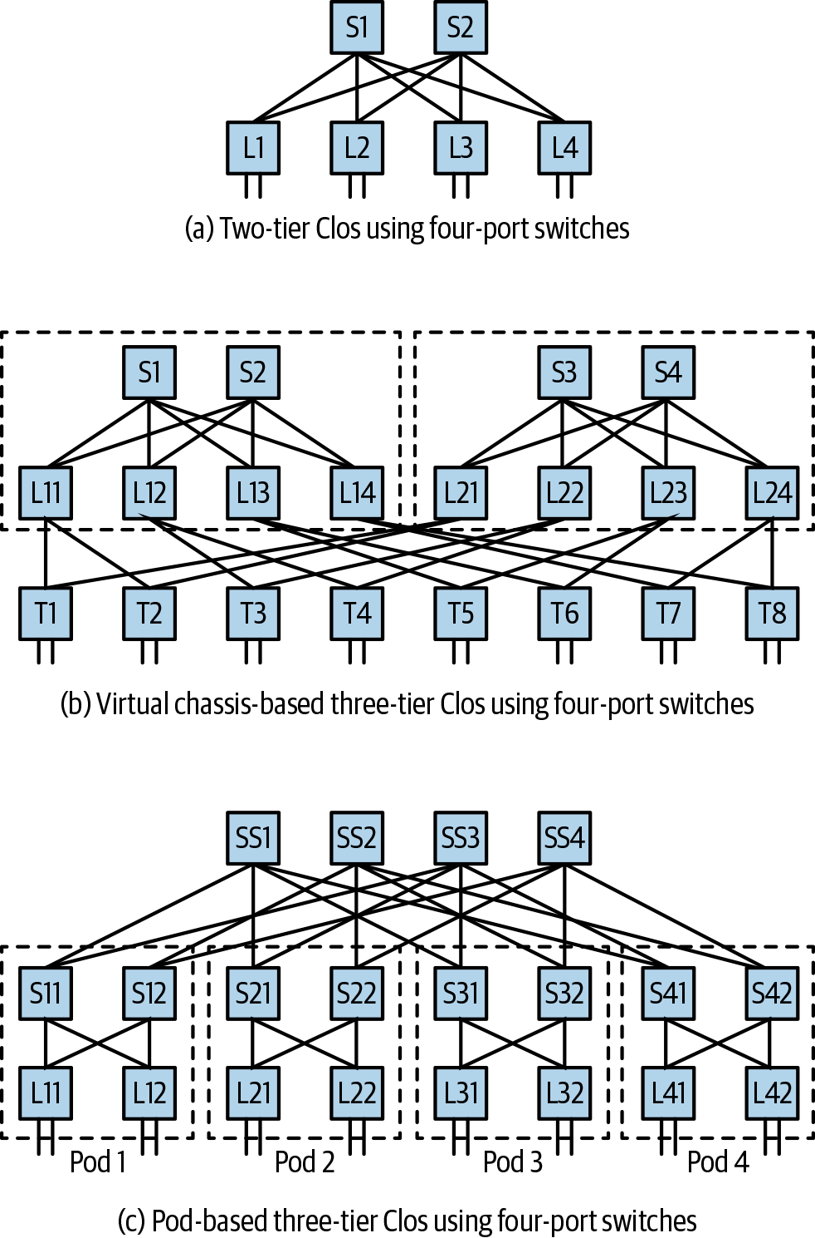
2-tier Clos (a) good for smaller enterprise data centers.
To scale to tens, even hundreds of thousands of servers requires a 3-tier architecture.
Two models:
Virtual chassis model (b)
Pod/cluster model (c)
Demonstrate using four port switches.

Slide 8
Scaling Clos: Virtual Chassis Model (b)
Called “virtual chassis” model because some vendors build chassis that contain dotted areas.
New row of leaf (T) switches.
Two ports to servers
Two ports to original leaf (L) switches
Get 16 servers versus 8 with 2-tier.
Used by Facebook

Slide 9
Scaling Clos: Pod/Cluster Model (c)
Another layer above spine (S) switches called “superspine” (SS) switches.
Group of four “S” and “L” switches are a “pod.”
Two ports from “S” to “SS” switches.
Mid- to very large data center operators.
Used by Microsoft and AWS.

Slide 10
3-tier Clos: Calculating Max Number of Servers
Number of servers in maximum buildout for number of ports.
Number of servers is n³/4 where n = number of switch ports.
4 port switches = 4³/4 = 16
32 port switches = 32³/4 = 8,192
64 port switches = 64³/4 = 65,636
128 port switches = 128³/4 = 524,288

Slide 11
3-tier Clos: Calculating Max Number of Switches
Number of switches in maximum buildout for number of ports.
Number of switches n + n² where n = number of switch ports.
4 port switches = 4 + 4² = 20
32 port switches = 32 + 32² = 1,056
64 port switches = 64 + 64² = 4,160
128 port switches = 128 + 128² = 37,056

Slide 12
Comparison
Servers | 2-tier | 3-tier
4-port | 4 | 16
32-port | 512 | 8,192
64-port | 2,048 | 65,636
128-port | 8,192 | 524,288
Switches | 2-tier | 3-tier
4-port | 6 | 20
32-port | 48 | 1,056
64-port | 96 | 4,160
128-port | 192 | 37,056
Mathematical possibilities. Actual implementation has limitations.

Slide 13
Compare VC to Pod/Cluster: Latency
Virtual chassis model
Average of three hops from any server to another in the same pod.
Average of five hops from any server in one pod to a server in another pod.
Two different latencies.
Best for data centers that run a single application: Facebook
Pod model
Every server is five hops from any other server.
Latency is more uniform.

Slide 14
Compare VC to Pod/Cluster: Data center expansion
Incremental build out usually desired.
Install only as many switches and servers needed now and add more later.
Initially need fewer switches and servers with pod model, up front investment is higher for virtual channel model.

Slide 15
Compare VC to Pod/Cluster: Data center expansion
Pod model can start with fewer switches.
Virtual channel model requires more switches and therefore up front investment.
With complete build out both models use the same number of switches.
Virtual channel model is preferred if you:
Know expansion estimates will be met.
Don’t mind paying CAPEX costs now, or
want to be able to turn up capacity quickly when needed.

